Slide 1
Harnessing Artificial Intelligence for Penetration Testing
Structured Approaches, Automation, and AI Advancements
Kiera Conway

Slide 2
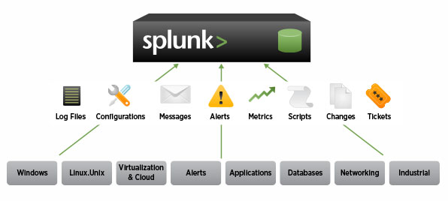
Splunk
Processing ‘Big Data’
“data that is so large, fast or complex that it’s difficult or impossible to process using traditional methods ^{[1]} ”
Features
Data Collection
Indexing
Analyze
Create Metrics
Diagnose Problems
Visualization
Used By
Data Management
IT Monitoring
Cybersecurity
Notes:
[1] Big Data: What it is and why it matters.
[2] (Photo) N. Kolakowski, Splunk and Cloudera Alliance Hints at New Big Data Landscape, 2013.

Slide 3
Penetration Testing: Practical Introduction & Tutorials Stephen Watts
Structured PT Approach
Information Gathering
Scanning
Exploiting
Maintaining Access
Covering Tracks
Reporting
Explores PT methodology
Significance
Uncover Weak Points,
Understand Potential Attack Scenarios
Analyze The Vulnerability Severity
Continuous Training
Practical Demonstrations

Slide 4
Penetration Testing: Practical Introduction & Tutorials Stephen Watts
Module Structure
Bridge Theory and Practice
Automation as a Solution

Slide 5
Autonomous Security Analysis and Penetration Testing (ASAP)
Advanced Techniques
Reinforcement Learning (RL)
Deep-Q Networks (DQN)
Attack Plans
Highly Detailed Series of Steps
Provide Domain-Specific Rewards
Address Limitations of Traditional Automation
Autonomous Security Analysis and Penetration Testing
Ankur Chowdhary, Dijiang Huang, Jayasurya Sevalur Mahendran, Daniel Romo, Yuli Deng, Abdulhakim Sabur

Slide 6
Network Assessment
Attack Graph Generation
State Graph
Attack Plan Generation and Validation
Autonomous Security Analysis and Penetration Testing
Ankur Chowdhary, Dijiang Huang, Jayasurya Sevalur Mahendran, Daniel Romo, Yuli Deng, Abdulhakim Sabur
Adaptive
Scalable
Real-World Application

Slide 7
Advanced AI Techniques
Reinforcement Learning
Deep-Q Networks
Real-world Application
Uncover Hidden Attack Paths
Optimize security assessments
Limitations
Network Size Costraints
Real-world Complexity Challenge
Autonomous Security Analysis and Penetration Testing
Ankur Chowdhary, Dijiang Huang, Jayasurya Sevalur Mahendran, Daniel Romo, Yuli Deng, Abdulhakim Sabur

Slide 8
References
Big Data: What it is and why it matters.
N. Kolakowski, Splunk and Cloudera Alliance Hints at New Big Data Landscape, 2013.
H. M. Z. A. Shebli and B. D. Beheshti, "A study on penetration testing process and tools," in Long Island Systems, Applications and Technology Conference (LISAT), Farmingdale, 2018.
M. C. Ghanem and T. M. Chen, "Reinforcement Learning for Intelligent Penetration Testing," in Second World Conference on Smart Trends in Systems, Security and Sustainability, London, 2018.
A. AlMajali, L. Al-Abed, R. Mutleq, Z. Samamah, A. A. Shhadeh, B. J. Mohd and K. M. Ahmad Yousef, "Vulnerability Exploitation Using Reinforcement Learning," in Jordan International Joint Conference on Electrical Engineering and Information Technology, Amman, 2023.
C. Kidd, What Is Splunk & What Does It Do? An Introduction To Splunk, 2022.
S. Watts , Penetration Testing: Practical Introduction & Tutorials, 2022.
A. Chowdhary, D. Huang, J. S. Mahendran, D. Romo, Y. Deng and A. Sabur, "Autonomous Security Analysis and Penetration Testing," in 16th International Conference on Mobility, Sensing and Networking (MSN), Tokyo, 2020.

